Slide 1


Voice of Nura: From Fear to Digital Protection
A comprehensive safety ecosystem dedicated to empowering women with tools to document, report, and respond to threats.
Project by: Elnura, Aisezim, Amina,
Akram, Aizhan

Slide 2
Design Thinking Roadmap
Empathize
Define
Ideate
Prototype
Test
The Voice of Nurai project began with a critical look at the "invisible" anxiety women face in Bishkek. Our research with over 100 students revealed a staggering 58% harassment rate and a profound distrust in official systems, with police trust rated at just 1.8/5. This data redefined our mission: we weren't just fighting crime, we were fighting isolation.
Moving away from traditional reporting tools, we ideated a Digital Shield focused on community-powered safety. We prototyped a stealth-mode mobile application featuring an Evidence Vault for secure documentation, SOS triggers with sub-10 second response times, and a Safe Haven Map of 50+ verified locations in Bishkek.
Validation testing proved our concept’s potential, showing a 64% decrease in user anxiety and an overwhelming 83% demand for volunteer escorts. Ultimately, the project successfully transitioned from a culture of silence to a network of active protection, turning a user’s fear into a digital plan for safety.

Slide 3

Empathy Stage 1: Nurai’s Story.
Our Problem (Why?)
Nurai was a young woman facing repeated stalking and harassment but lacked the tools and support to protect herself.
We created this platform to ensure that no one else faces danger alone, without the means to seek help or document threats.
"Voice of Nurai was born from a tragedy that should never have happened."
"We honor Nurai's memory by empowering women with the digital tools they deserve."

Slide 4

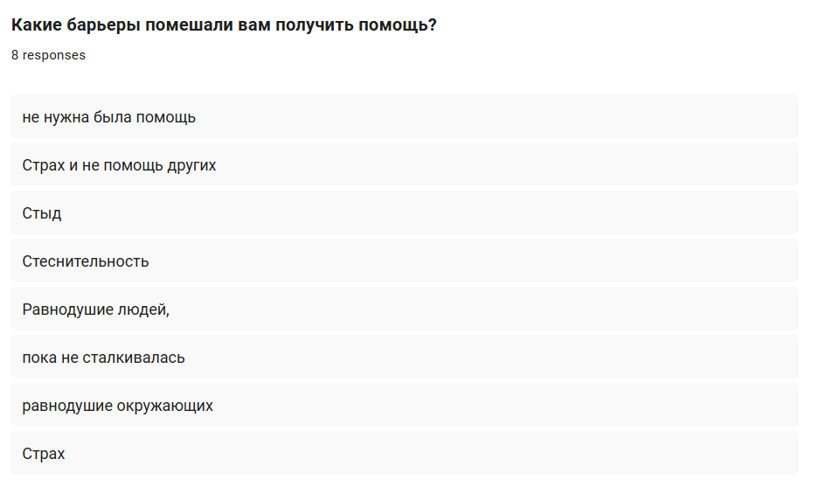
Define Stage 2: Demographics & Profile
92%
83%
Female Respondents
Aged 18–25 (Students)
The primary target is women, specifically the most vulnerable demographic in urban centers.
Most live with parents and navigate public transport/walking routes daily for studies.
Current Mobility & Health
• 91% have no permanent health limitations.
• 75% rarely/never wear shoes that hinder mobility (heels).
• Result: Users are physically mobile but limited by environment.

Slide 5



The Vital Fear Statistics
58%
Barriers to Help
• Indifference of others • Shame & Stigma • Fear of attacker retaliation • Police Negligence
Experienced Stalking or Harassment
Includes "Ala-Kachuu" (bride kidnapping) reported by 50% of the social circle.
Psychological State: 83% experience severe anxiety or hyper-vigilance ("constant space control") when returning home late.
"Women face negligence from state bodies... leading to a desire to remain silent."

Slide 6


Digital Safety & System Trust
Systemic Trust (Score 1-5)
Desired Features
1.8
91% want Safe Haven locations.
83% want Volunteer Escorts.
Avg. Trust in Police Response
Respondents cite "negligence" and "lack of justice" as reasons for not reporting incidents.
75% lack self-defense tools.
User Voice: Advice to Others
"Don't be afraid to give back, don't be ashamed to ask for help... even if your idea of danger seems 'crazy' to you, tell someone so there is a witness."
Primary Request: "Respond to the problem early, before it's too late."

Slide 7
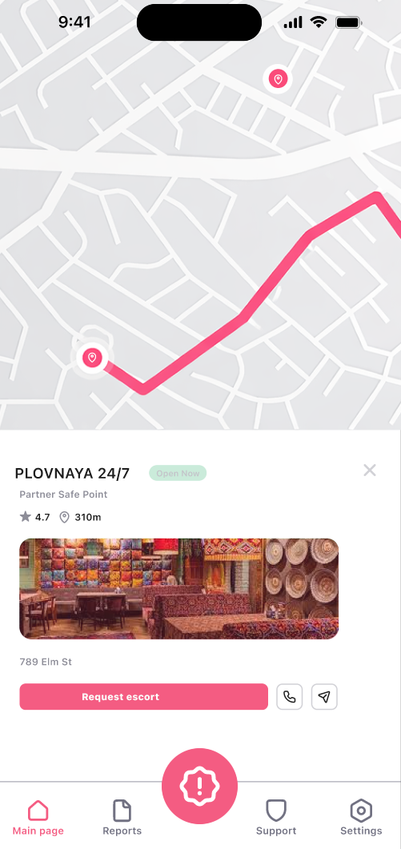
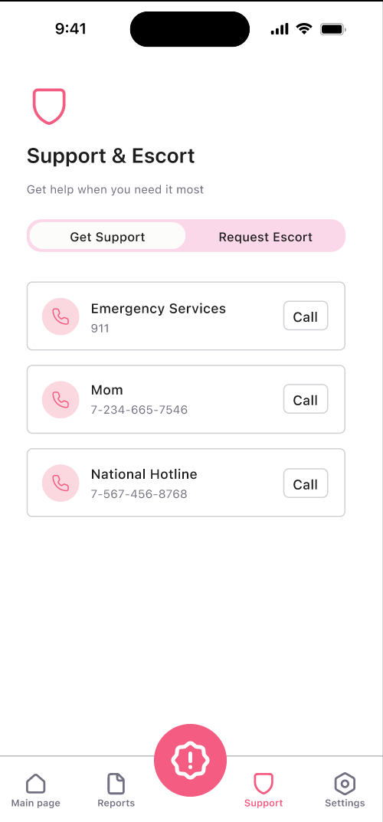
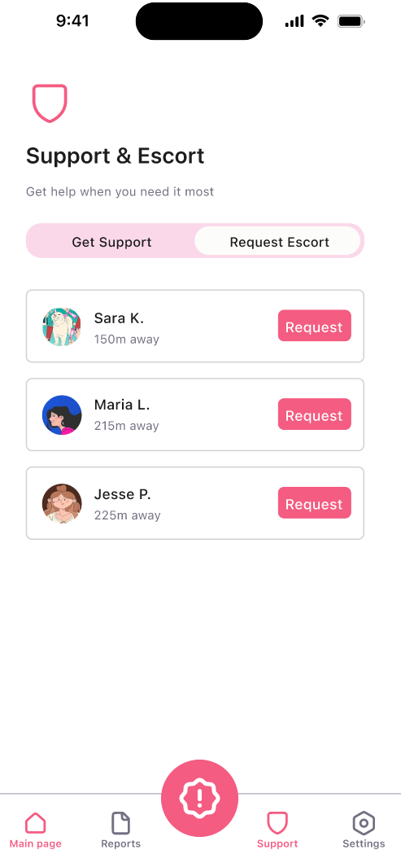
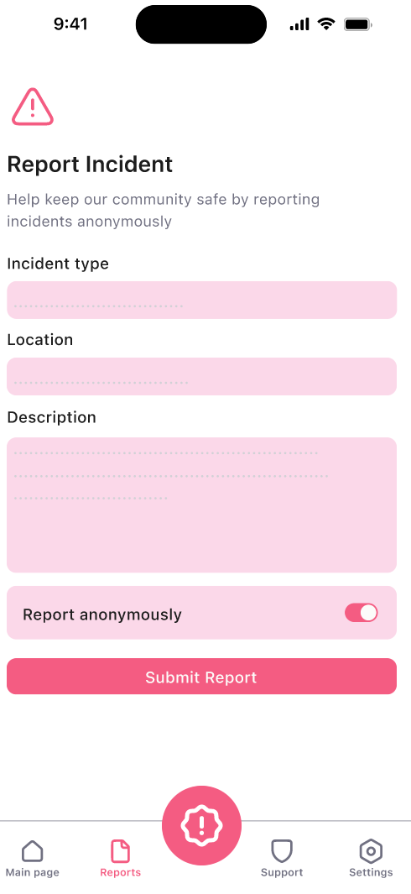
Mission and Vision (The Goal)
The Mission
Provide immediate access to safe spaces.
Enable instant emergency alerts.
To prevent tragedies by making danger visible, trackable, and actionable.
Facilitate anonymous incident reporting.
Build a community-based safety ecosystem.

Slide 8








Ideate Stage 3: Core Values of the Platform
Community
Empowerment
Connecting volunteers, verified safe spaces, and support networks for real-time vigilance.
Giving women control over their safety with tools to document, report, and respond on their own terms.
Immediate Action
Safety First
Enabling quick access to resources when seconds matter most during a high-risk encounter.
Every feature is designed with user safety and absolute privacy as the top priority.

Slide 9


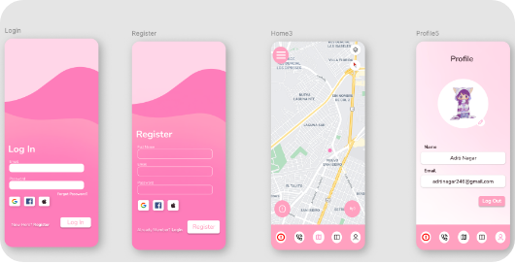
Feature: Emergency SOS
1. One-Press Alert: Pressing the SOS button instantly alerts all trusted contacts.
2. Real-Time Data: Contacts receive your live location and a custom help message.
3. Verification: Test messages help ensure your contacts are ready for a real crisis.
Best Practice: "Keep at least 2-3 trusted contacts for safety."

Slide 10

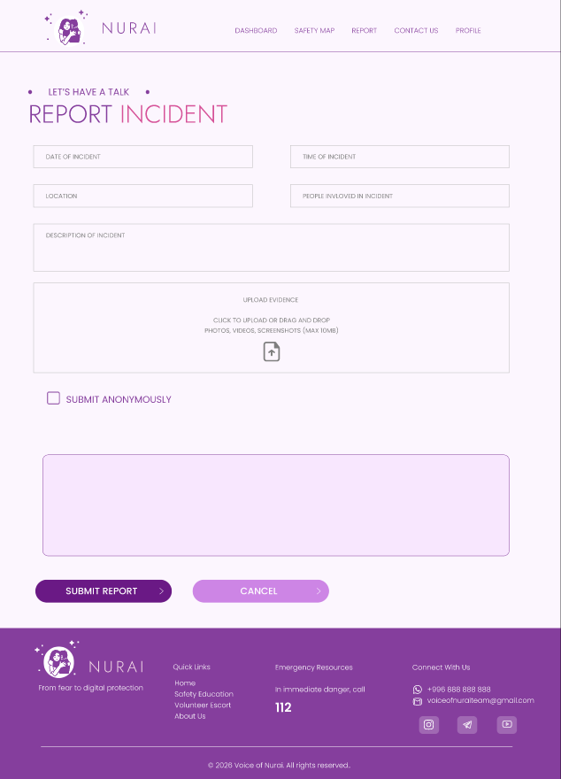
Anonymous Incident Reporting
Documentation
Upload photos, videos, and screenshots (Max 10MB) as permanent evidence.
Confidentiality
"Your personal information will not be shared. The report will help track patterns and protect others."
Official Use:
All reports are securely stored and can be accessed by authorities if needed for legal action. We help bridge the gap between fear and justice.

Slide 11

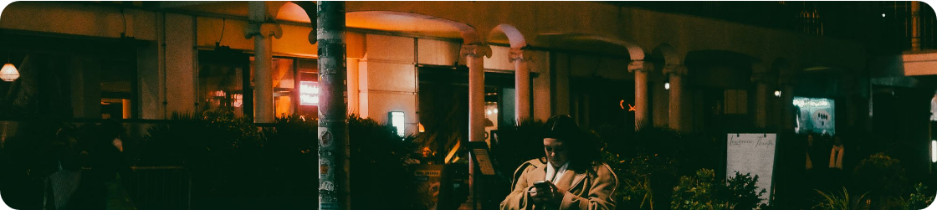
Volunteer Escort Service
Connects users with a verified person who can accompany you if you feel unsafe.
1. Submit Request
2. Get Matched
3. Safe Journey
Fill out route and time details via the platform.
A trusted, verified volunteer is assigned to you.
Meet the volunteer and travel safely to your destination.

Slide 12
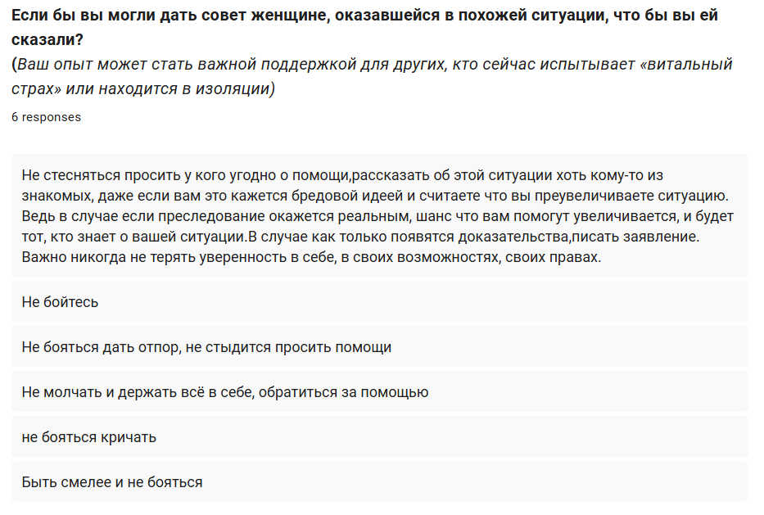
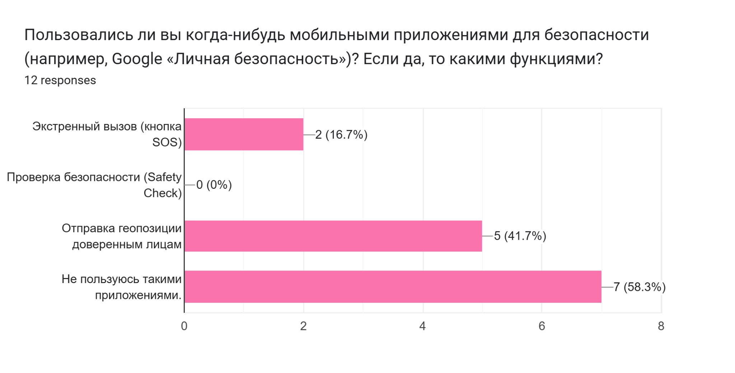


Emergency Resources
Warning Signs
Repeated unwanted contact
Following or surveillance
Unwanted gifts or messages
Monitoring online activity
Direct Platform Support
Nurai Companion AI
Phone: +996 888 888 888
The AI system suggests SOS mode automatically when risk triggers are high based on behavior patterns and context.
Email: voiceofnuraiteam@gmail.com
Locations: Erkindik Ave 14 and Chingiz Aitmatov Ave 23, Bishkek.

Slide 13



Mental Health and Inner Safety
"Clarity comes when you pause, listen to yourself, and let things unfold naturally."
— Dr. Aizada Toktogulova
Led by experts, we focus on building resilience. "One message at the right moment can prevent panic."
"If something feels wrong, it probably is. Don't ignore your gut feelings."
Stay Aware
Stick to Lighting
Avoid distractions like phones when walking. Let trusted contacts know your ETA.
Choose routes with good lighting and avoidshortcuts or isolated paths.

Slide 14

GitHub Repository: https://github.com/AkramArysl/Voice-of-Nurai.git
Trello:
https://trello.com/invite/b/6a0c11f86edfc860cb509f2c/ATTId99cf0dc62df9fc4ca905d8f3801b660B8EDD7A5/voice-of-nurai

Slide 15
Questions?
Thank you for your attention.
voiceofnuraiteam@gmail.com

